Slide 1
Expected Applications of DAD in our studio
0 Collect information via site surveys by my group
1 Quantitatively analyze selected cases worldwide
2 Understand quality of space with self collected pictures or street view pictures
3 Study the design site from functional and activity dimensions with emerging new data using the open GIS software GeoDA

Slide 2
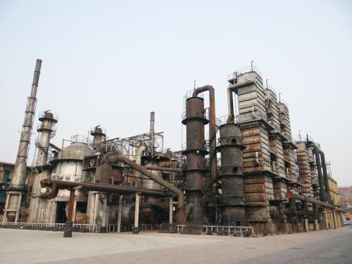
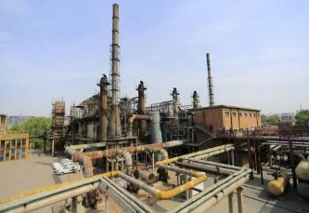
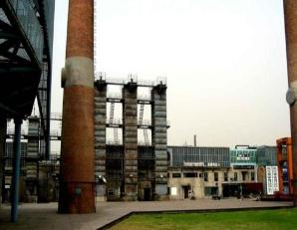
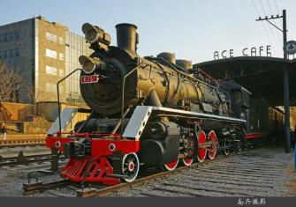
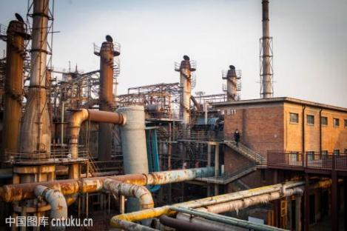
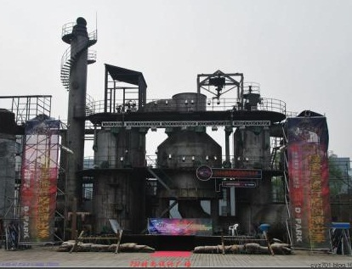
Understand the elements of the site
Pictures on the web
There are many pictures about 751 on the web.

Slide 3
Learn from other excellent cases
General information
Data
Information of city and population
Brief introduction of the case
Image of location
Urban pattern with building footprints
Floor number
Data sources
Wikipedia, Twitter, Facebook
Official website,
Twitter, Facebook, Tourism website
Twitter, Facebook, Tourism website, Google street viewer
Open street map, Google earth(360 cities)
Google earth (360cities),
Google street viewer
Detailed information
Data
photos
Images
diagram
text
Google Street View pictures
Data sources
Twitter, Facebook,
Instagram,
Linked in
Youtube
Google map
(Google earth )
NASA
Twitter, Facebook, Tourism website, Official website
Official website,
Twitter, Facebook,
Linked in
Google map
(Google earth )
In China, there are some other resources of data
Baidu map, Baidu pictures, Wechat, Sina microblog

Slide 4
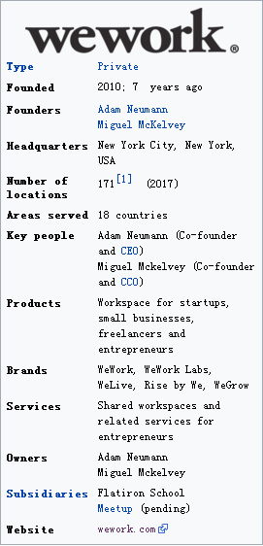
Case study: sharing work：Wework in London South End，UK
WEWORK: https://www.wework.com
WELIVE: https://www.welive.com
WEGROW: https://wegrowapp.com/
We can scan the basic information about wework
WeWork is an American company which provides shared workspaces, technology startup subculture communities, and services for entrepreneurs, freelancers, startups, small businesses and large enterprises. Founded in 2010, it is headquartered in New York City. WeWork has a current valuation of roughly US$20 billion and manages 10 million square feet of office space.
WeWork designs and builds physical and virtual shared spaces and office services for entrepreneurs and companies. The company’s 100,000+ members have access to health insurance, an internal social network, social events and workshops, and an annual summer retreat.

Slide 5
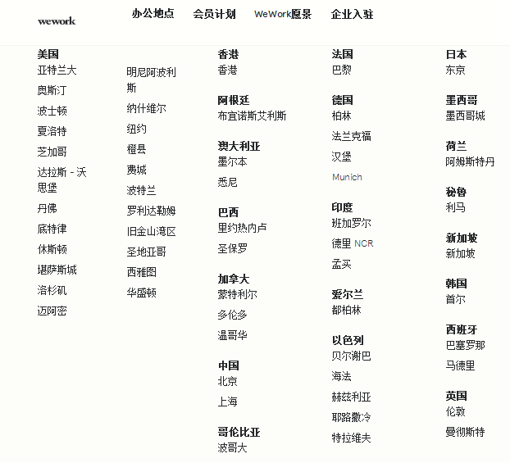
General information
WeWork has more than 2000 employees and has locations in 59 cities and 20 countries including Australia, Argentina, Brazil, Canada, China, Colombia, France, Germany, India, Ireland, Israel, Japan, Mexico, Netherlands, Peru, Singapore, South Korea, Spain and United Kingdom.
There are 32 WeWork offices in London
We can find basic information about wework in London, and the reason to choose someplace. Besides, we can catch the detail information about every coworking space.
WEWORK: https://www.wework.com

Slide 6
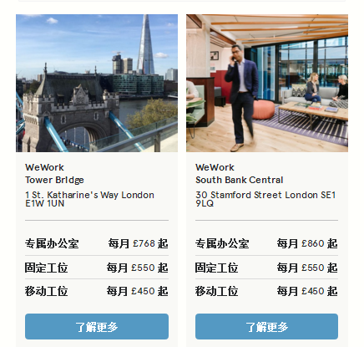
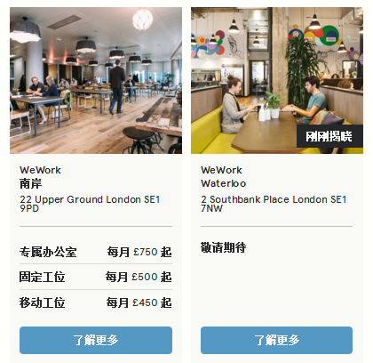
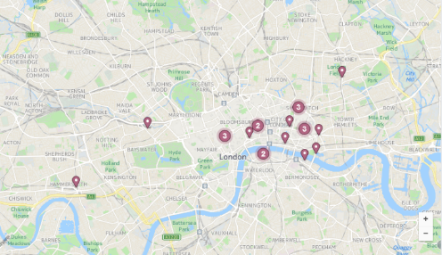
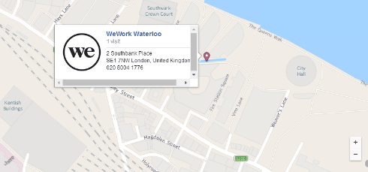
Detail information
There are 4 WeWork offices in in London South End
Why they choose South Bank?
With theatres, galleries, dance companies, and film studios, South Bank is always bustling with cultural events. Businesses in entertainment, hospitality, and tourism are attracted to South Bank office space for its scenic strolls and abundant art venues.
We can get the detail information including locations.

Slide 7
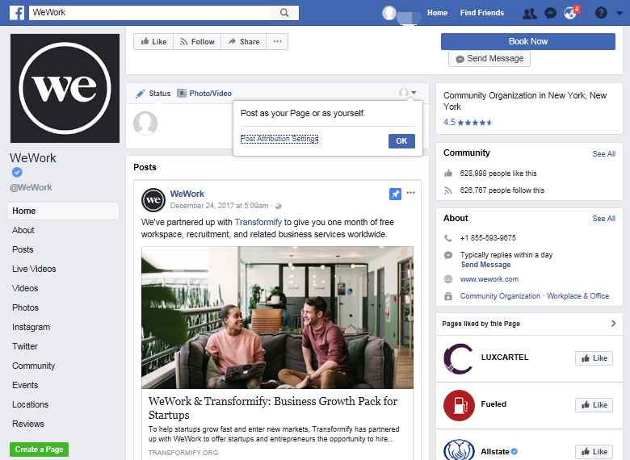
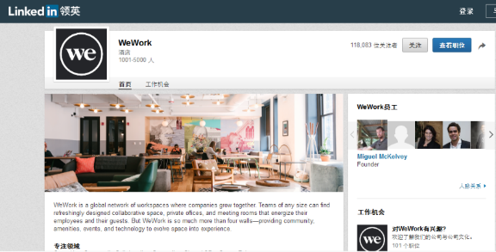
Photos, videos, posts, events, locations and reviews are available in Twitter, Instagram, Facebook, and Linked in.

Slide 8
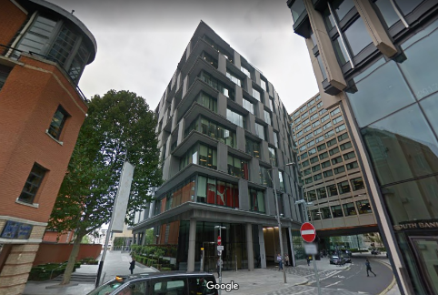
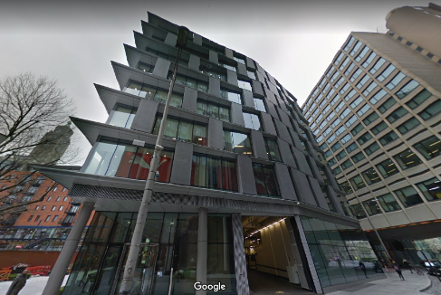
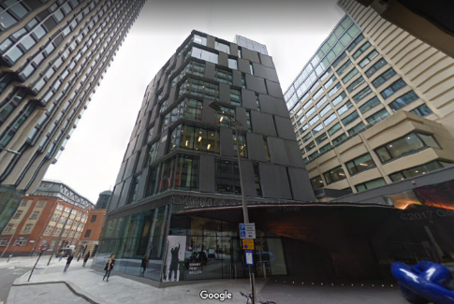
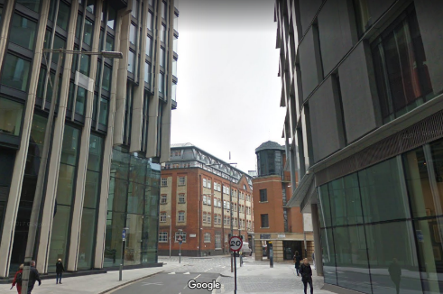
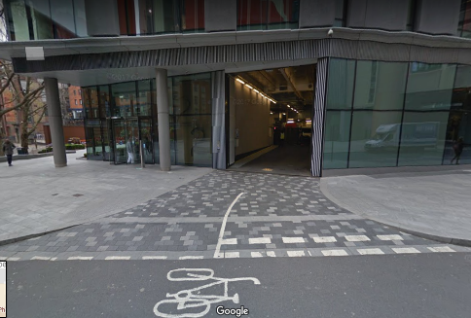
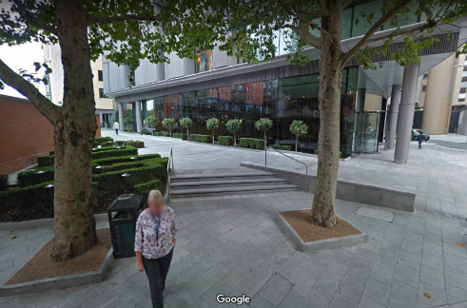
Google street view pictures
Identify the quality of space from its attractiveness, vitality, safety and history
http://www.google.cn/maps/@51.5076784,-0.1068119,15z

Slide 9
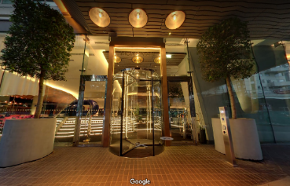
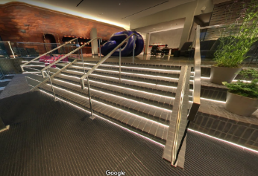
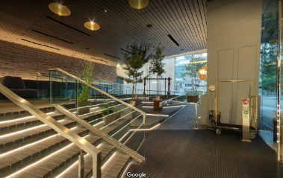
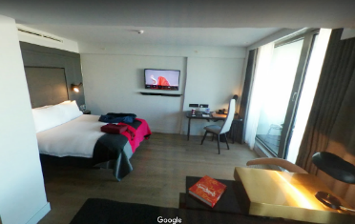
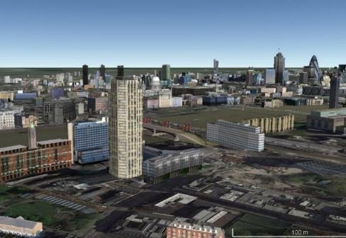
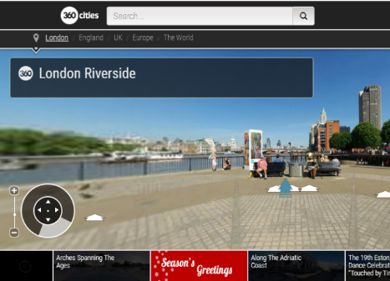
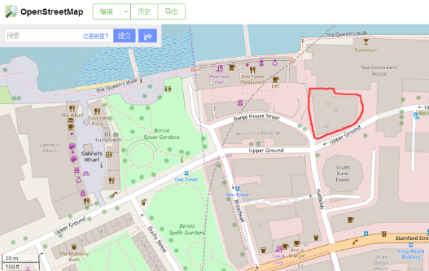
Other pictures
Some indoor scenes are available in google street viewer
Three-Dimensional Building
360 Cities
Open street map
Google Earth software
https://www.360cities.net/
http://www.openstreetmap.org/#map=18/51.50780/-0.10868

Slide 10
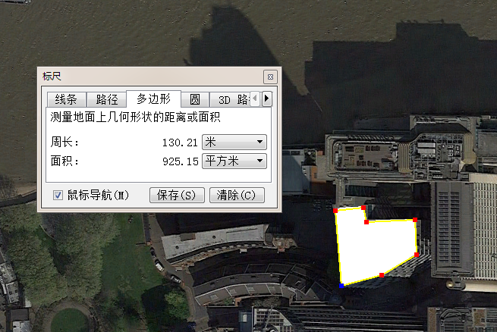
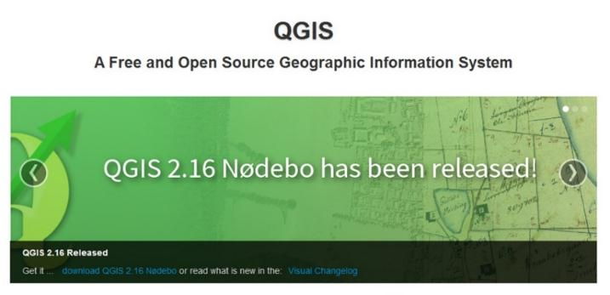
Quantitatively analysis
traffic organization, network characteristics, open space, building texture, etc. can be analyzed via open street map and google earth.
In small scale
In large scale
Layer：8
Perimeter：130m
Area：925㎡
Quality of space :
quiet, comfortable, clean and new
http://www.openstreetmap.org/#map=18/51.50780/-0.10868
Download QGIS://www.qgis.org/en/site/forusers/download.html

Slide 11
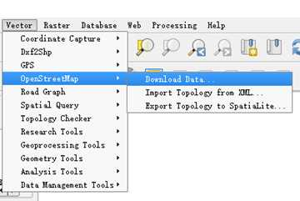
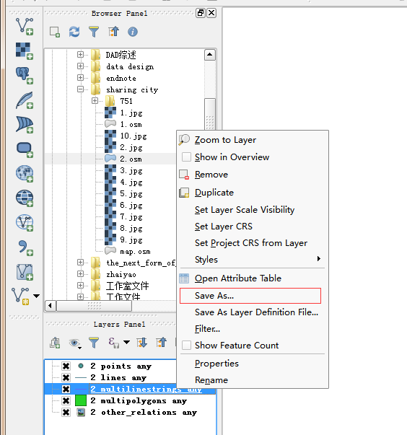
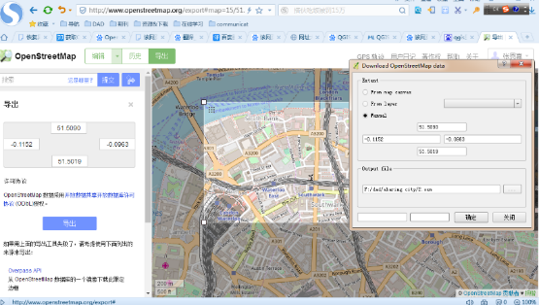
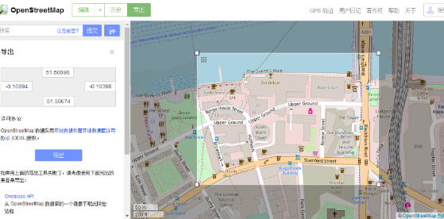
Step1: Download the open street map from QGIS software or in the website.
Step2: Select data in the QGIS's content list, right-click, select Geometry Tools-, click Saved /Export/Add geometry column, export to SHP suffix data, and then edit it in ArcGIS software.
①
②
https://zhuanlan.zhihu.com/p/25889246

Slide 12
Data and Resources
Data type | Database name | Main information | website
Open data | Creative Commons | Sharing Knowledge | https://creativecommons.org/
 | Open Access Library | Open journal articles, technical reports, dissertations | http://www.oalib.com/
 | open street map | Map with street information | http://www.openstreetmap.org/#map=15/51.5057/-0.1046
 | Global geographic GeoJSON data | Various geospatial data information
 | SVG-EPS map | Vector map data | http://bbglab.irbbarcelona.org/svgmap/
 | Global cities Data | Bike data | http://www.lboro.ac.uk/gawc/group.html
 | sightsmap | Photo address information | http://www.sightsmap.com/#
 | Public data from the government | Human data: economy, industry, education, population, road traffic; Natural data: geology, topography, climate, soil, hydrology
Social data | WeChat, blogs, twitter, Wiki, Facebook, Linked in, etc. | E - mail, documents, pictures, audio, video
Enterprise data | Baidu, Google, MapABC, MapBar, Sina micro-blog, Sogou, United Nations comprehensive database, International Monetary Fund, CEIC global database, world bank, World Bank EdStats, Taobao, Alibaba, Jingdong | Space, society, economy, education, Shopping
http://mp.weixin.qq.com/s?src=3&timestamp=1515401421&ver=1&signature=qZStl*2RcaqxL2O4JLB3F2KIq0mLXME3CgAXrOhr2UyrHtm1Xt22cdACG8oMpkBZfGXdBAeN006hTMP12uqnj91XawYMKy3xEPE0oNcW04yu3WVMgsfrMKJzRyAIH8c1WYsd*NWBh7VTo9debcpUZQ==
http://mp.weixin.qq.com/s?src=11&timestamp=1515412736&ver=624&signature=VbtgzWuyXebGqJ01DCK1*G9dydl-BRF3jgoXb08KQa2Ce3OI28XmTKmCdHdvyVHyM1RsXf*8LXHoOeIJNuiIoNg1ntnSS-UkId8kVLOwM6jFyj7W7Zxe3JP1l4yzf0Z1&new=1

