Slide 1
Urban growth simulation using V-BUDEM
a vector-based Beijing urban development model
Yongping ZHANG^{1,2,3}, Ying LONG^{4*}
¹School of Urban Planning and Design, Peking University
²Nijmegen School of Management, Radboud University Nijmegen
³School of City and Regional Planning, Cardiff University
⁴Beijing Institute of City Planning
2013-08

Slide 2
Outline
1. Introduction
2. V-BUDEM
3. Model application
4. Conclusion and discussion

Slide 3
1. INTRODUCTION

Slide 4
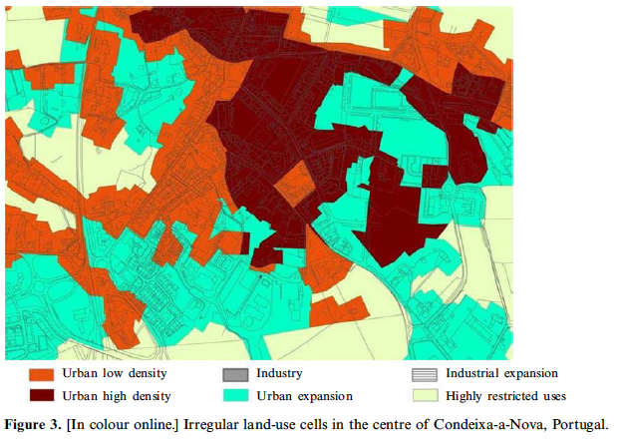
Vector CA
Raster CA extensively applied for simulating urban growth
  Batty, Clarke, Engelen, Li, White, Wu, Xie, Yeh
Simulation results of raster CA sensitive to grid resolution and neighborhood configuration
  Jenerette and Wu (2001), Chen and Mynett (2003), Jantz and Goetz (2005), Ménard and Marceau (2005)
Vector , or irregular CA, more representative to the real world
  Geographical entities (e.g. parcels, with Shi and Pang 2000 as an exception using Voronoi polygon) replace grids

Slide 5
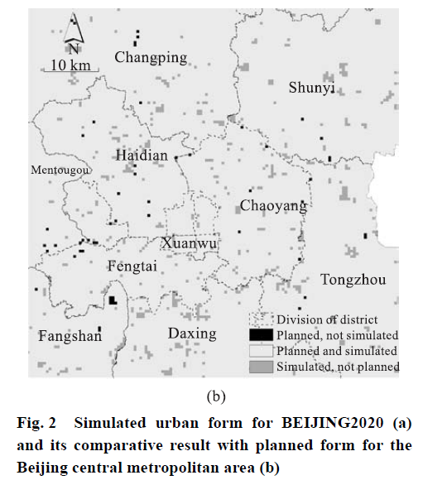
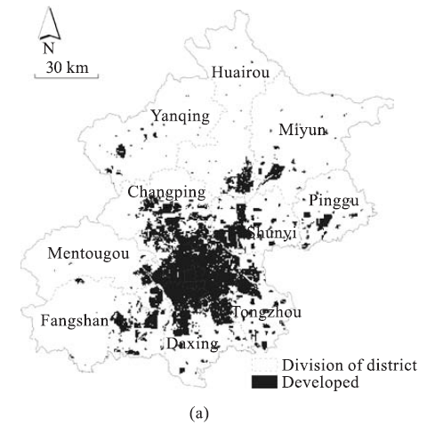
BUDEM
Long et al, 2009 （Tsinghua Science and Technology）
  Beijing Urban Development Model
  Raster CA
  Supporting city planning and corresponding policies evaluation
  Urban built-up & non urban built-up
Notes:
2009年清华学报英文版

Slide 6
This paper is regarded with
  Improve initial raster BUDEM into vector V-BUDEM
  Focused on the urban growth simulation at this stage
  Test it in a small town of Beijing

Slide 7
2. V-BUDEM

Slide 8
Spatial factor selection
Spatial variables in V-BUDEM
  Same with those in BUDEM
Type of variables | Name | Value | Description
Self-status | Isrural | 0, 1 | Whether the cell is rural built-up land in the previous iteration
 | Isagri | 0, 1 | Whether the cell is agricultural land in the previous iteration
Location | d_tam | ≥0 | Minimum distance to Tian’anmen Square
 | d_vcity | ≥0 | Minimum distance to important new city
 | d_city | ≥0 | Minimum distance to new city
 | d_vtown | ≥0 | Minimum distance to important town
 | d_town | ≥0 | Minimum distance to town
 | d_river | ≥0 | Minimum distance to river
 | d_road | ≥0 | Minimum distance to road
 | d_bdtown | ≥0 | Minimum distance to town boundaries
Government | Planning | 0, 1 | Whether planned as urban built-up
 | con_f | 0, 1 | Whether in the forbidden zone
 | Landresource | 1-8 | Land suitability classified for agriculture
Neighbor | Neighbour | 0-1.0 | Neighborhood development intensity
Notes:
为使研究具有连贯性，且便于比较，V-BUDEM模型内考虑的因素和BUDEM 完全一致
Planning 即规划的影响
Variables isagri and isrural stand for the transition from agricultural land and rural built-up land into urban built-up land, which is a concern of the Beijing Municipal Government. 模型考虑了政府政策的约束作用，主要从这两个体现，也比较有中国特色

Slide 9
Conceptual model
The Beijing metropolitan area (BMA)
The parcel —— the cell
The neighbourhood
  all parcels surrounding the cell within a certain distance
  CA states
  1 for urban built-up land
  0 for other land
The transition rule
  Multi-criteria evaluation (MCE)
Notes:
Rural built-up land 也属于other land

Slide 10
Parcel subdivision
Parcel subdivision is common in reality
  Alexandridis and Pijanowski (2007) ; Vanegas et al. (2008); Wickramasuriya et al. (2011, 2013)
  Introduce a semi-automated method
  Intersect current and planned land use pattern, keeping all attributes;
  Summarize the total area, according to Plan_ID and land type (e.g. urban built-up and other land);
  Summarize the total area, according to Plan_ID;
  Join tables created by step 2 and 3, according to Plan_ID. Each Plan_ID corresponds to a land type, which owns the maximum area ratio.
  Join the result of step 4 with planned land use pattern, and we get the subdivided current land use pattern.
Notes:
A mini innovation

Slide 11
Simulation process

Slide 12
Simulation process

Slide 13
The transition rule
development suitability
final transition probability
random item
Notes:
Ptg is the initial transition probability
Y is the random value varying from 0 to 1, k is the random index used to regulate RI, and α is the dispersion parameter ranging from 1 to 10, which indicates the rigid level of development.
The larger α indicates stricter development control and lower development probability with the same suitability.

Slide 14
3. MODEL APPLICATION

Slide 15
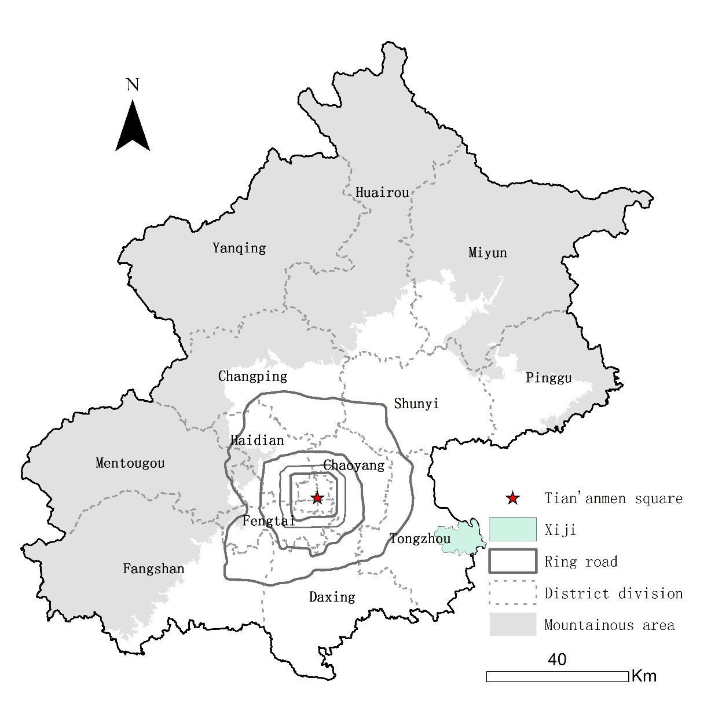
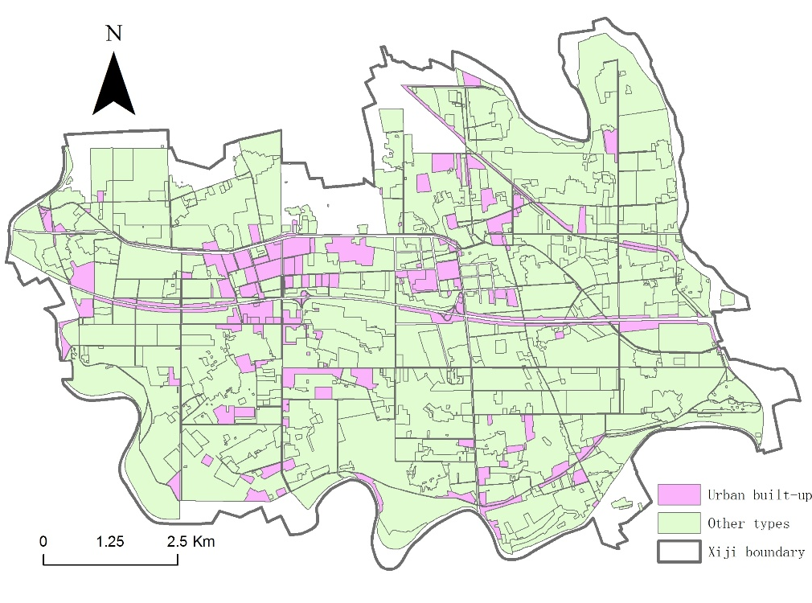
Study area
The Beijing metropolitan area
The current land use pattern of Xiji Town in 2010

Slide 16
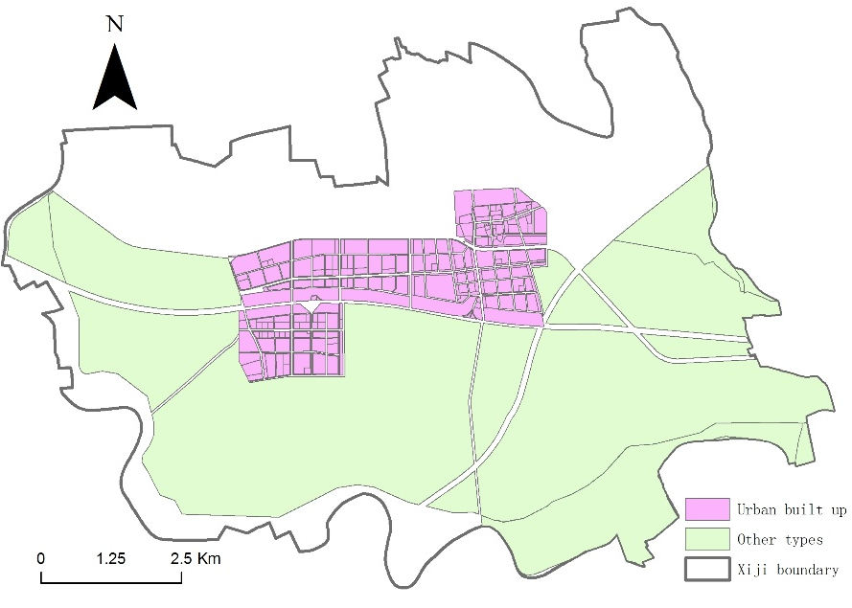
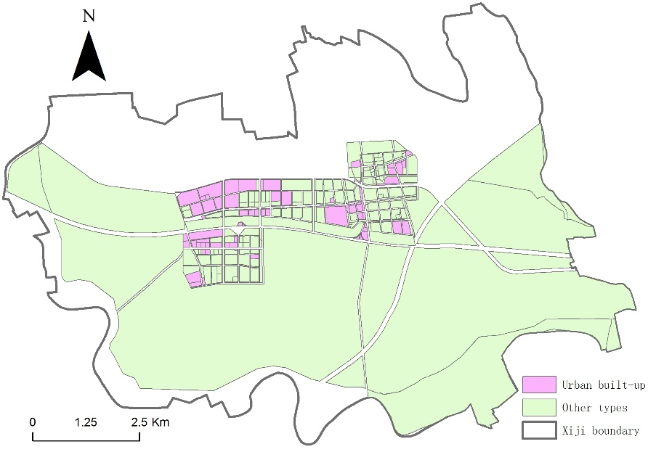

After parcel subdivision
The changed current land use pattern
The planned land use pattern

Slide 17
XIJI2020 simulation
From 2010 to 2020
Policy parameter set for 2006-2020
  The whole BMA
Name | Coefficient | Name | Coefficient
isrural | 6.886 21*** | d_river | -0.000 52***
Isagri | 6.971 87*** | d_road | -0.000 96***
d_tam | -0.000 10*** | d_bdtown | -0.000 27***
d_vcity | -0.000 03*** | planning | 8.770 71***
d_city | -0.000 10*** | con_f | -0.200 97*
d_vtown | -0.000 28*** | landresource | -0.093 55**
d_town | -0.000 11*** | neighbor | 4.598 08
***p (significance) = 0.001; **p = 0.05; *p = 0.5
Notes:
直接引用2009清华学报里，针对整个北京识别的2006-2020参数

Slide 18
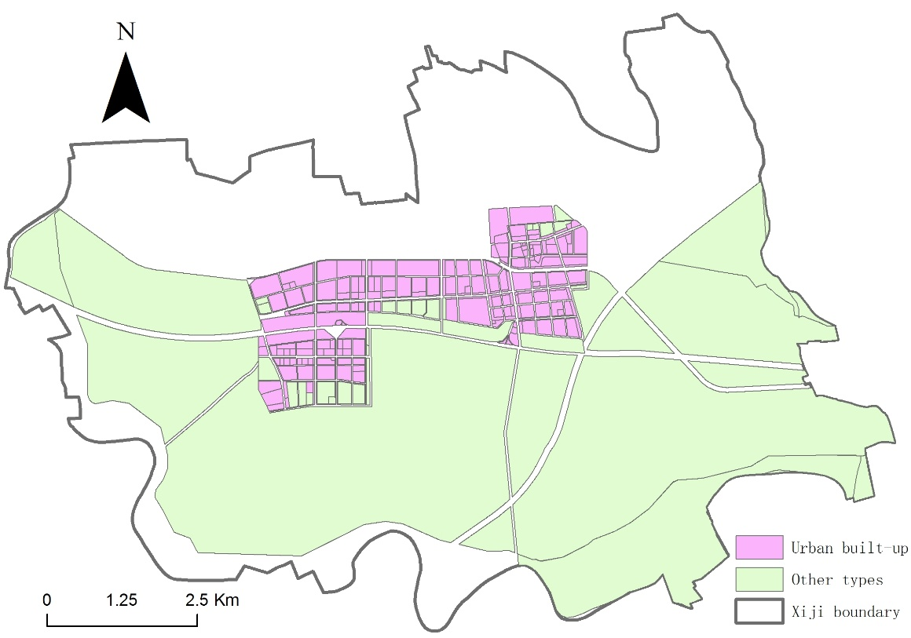
V-BUDEM result
Neighborhood distance = 60 m
  Tested 10-100 m
Time step
  5 times with a total of 10 years
Kappa = 86.52
Developed area
  6.95 km²
  smaller than predicted 8.77 km²
  Large parcels
Simulation result in 2020 using V-BUDEM
Notes:
选取邻域距离的原则是，保证所有parcel的邻域面积不为空（即存在邻域地块）的最小距离，
大地块的面积比各阶段的增长面积都大，导致即使该地块按probability应该变成urban built-up land,但不符合增长面积的约束

Slide 19
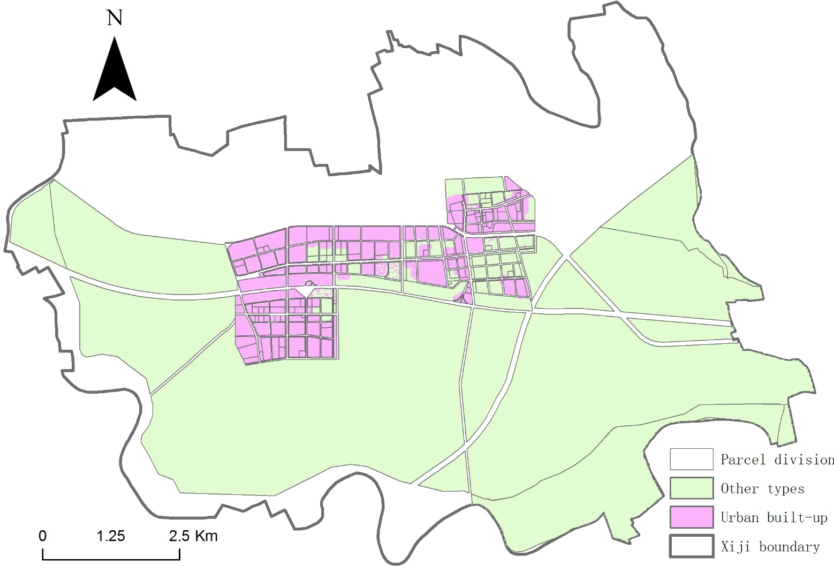
BUDEM result
30*30 m grid
Kappa = 79.51
Simulation result in 2020 using BUDEM

Slide 20
Result comparison
Using the parameter set to Xiji in V-BUDEM was comparatively more suitable than that in BUDEM
In V-BUDEM
  The parcel would be developed or undeveloped as a whole unit
In BUDEM
  Part areas of some parcels would be transited into urban built-up land, while other part areas would keep other land type
    Unlikely to be happened in reality
  Parcel space was a little different with the space consisted by grid
    For cell boundary could be out of parcel boundary, and it could cause some inaccuracies as a result.

Slide 21
5. CONCLUSION AND DISCUSSION

Slide 22
Conclusion
V-BUDEM was proposed, and a preliminary test was conducted
  more close to the real situation
aiming to the application of urban planning
  comprehensive constraints
  basic farmland protection and forbidden built-up areas
The semi-automated parcel subdivision method
  a new solution
  determine the basic simulation spatial units for V-BUDEM
  easy to implement and speed-up the model run

Slide 23
Future work
  Expand to the whole BMA
  Integrated automated parcel subdivision tool
  Wickramasuriya et al. (2011)
  Established the land use pattern in detail
  Residential, commercial, and industrial land types
  Planner Agent (Zhang and Long, 2013)

Slide 24
Thanks！
longying1980@gmail.com
Notes:
Readings

